Slide 1
Energy efficient UDN design using reinforcement learning
DGIST
BongSang Kim
JaeHyun Lee
19/July/2019
UGRP Meeting

Slide 2
Progress
Design Env code
Design RL code – MCTS
Remodel based on sample library
Most of MCTS libraries are for sequential game
→ We decided to mcts.py module instead of using MCTS library
Make 2 module
main.py: UDNEnv(environment code)+MCTS(RL code)
ppp.py: BSposition.csv(information of BS position) create

Slide 3
System Model
Environment model
16-users and 10-BSs are deployed in the area
BS location is PPP
User location is uniform distribution which changes every step
전원 off 된 BS와 user까지의 거리를 infinity로 하여 association을 막음
MCTS model
Utilize MCTS library on Github
Most of MCTS libraries are for sequential game
We decided to edit the library for our environment model

Slide 4
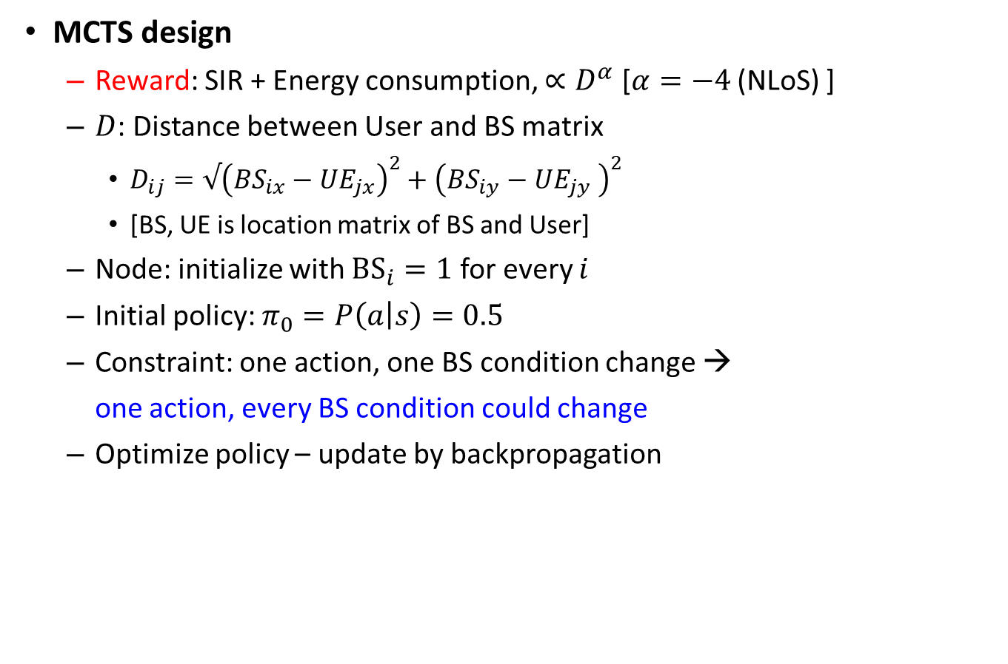
System Model
MCTS design
Reward: SIR + Energy consumption, $∝D^{α}$ [$α=−4$ (NLoS) ]
$D$: Distance between User and BS matrix
$D_{ij}=√{\left(BS_{ix}−UE_{jx}\right)}^{2}+{\left(BS_{iy}−UE_{jy} \right)}^{2}$
[BS, UE is location matrix of BS and User]
Node: initialize with ${BS}_{i}=1$ for every $i$
Initial policy: $π_{0}=P\left(a | s\right)=0.5$
Constraint: one action, one BS condition change →
one action, every BS condition could change
Optimize policy – update by backpropagation

Slide 5
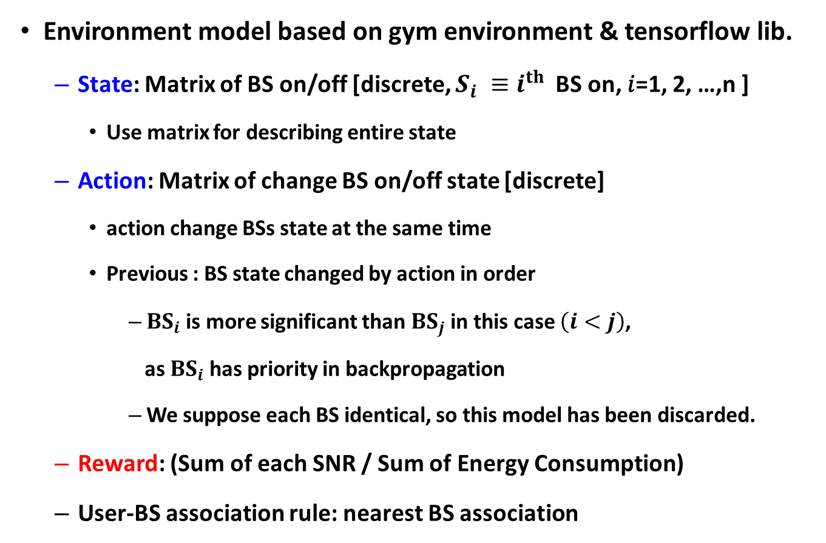
System Model
Environment model based on gym environment & tensorflow lib.
State: Matrix of BS on/off [discrete, $S_{i} ≡i^{th}$BS on, 𝑖=1, 2, …,n ]
Use matrix for describing entire state
Action: Matrix of change BS on/off state [discrete]
action change BSs state at the same time
Previous : BS state changed by action in order
${BS}_{i}$is more significant than ${BS}_{j}$ in this case $\left(i<j\right)$,
as ${BS}_{i}$has priority in backpropagation
We suppose each BS identical, so this model has been discarded.
Reward: (Sum of each SNR / Sum of Energy Consumption)
User-BS association rule: nearest BS association

Slide 6
System Model
Make 2 python module
main.py: UDNEnv(environment code)+MCTS(RL code)
ppp.py: create BSposition.csv(information of BS position)

Slide 7
System Model Structure
Class : UDNEnv
__init__
Initialize parameters, BS position, depthLimit
isTerminal
decide whether the state is terminal or not
step
$$calculate Bsdistance/EnergyConsumption/SNR/reward$$
Association
associate BS/UE by association rule
getPossibleAction
return list of every possible action
takeAction
return the state according to action
getReward
return the reward of specific state
render
Display the environment (not use)

Slide 8
System Model Structure
Class : mcts
__init__
initialize parameters
search
search Tree until iterationlimit
executeRound
update node/reward, do backpropagate)
selectNode
decide next node
expand
expand new node
Backpropagate
backpropagate the tree
getBestChild
find possible bestNodes
getAction
return action of bestnode

Slide 9
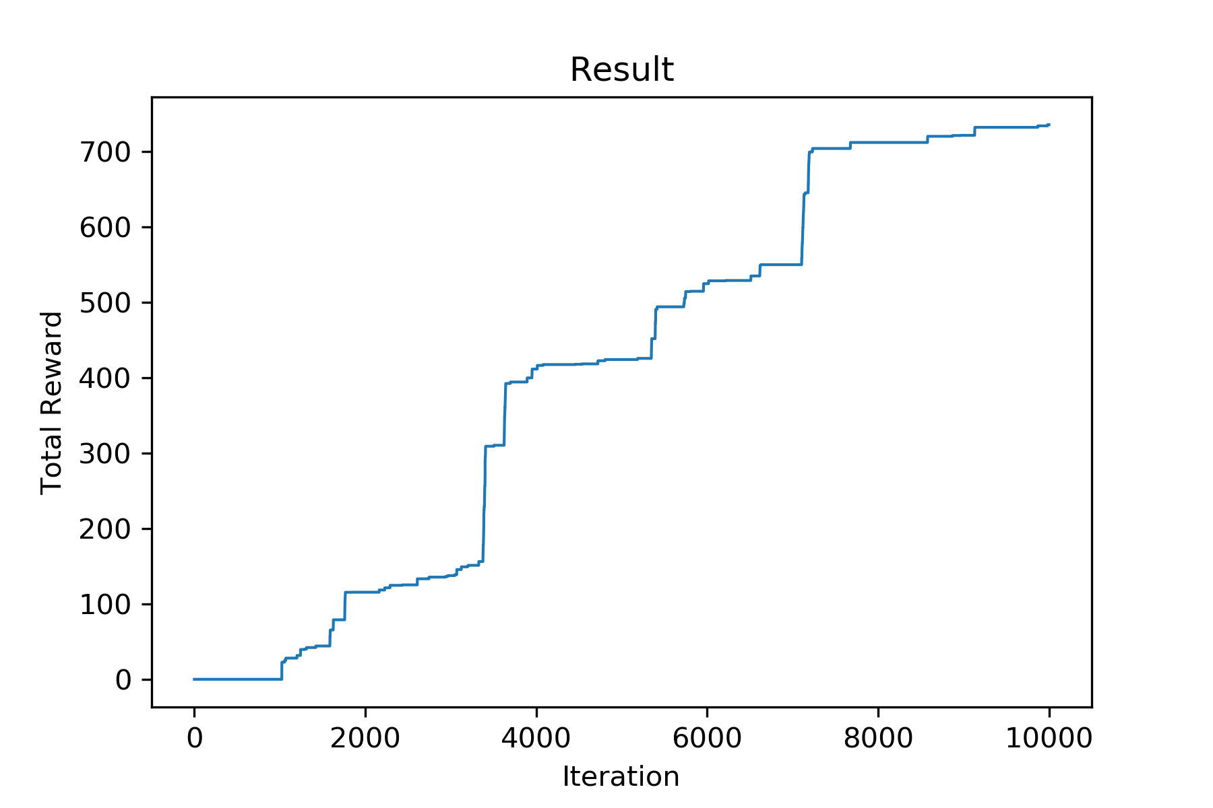
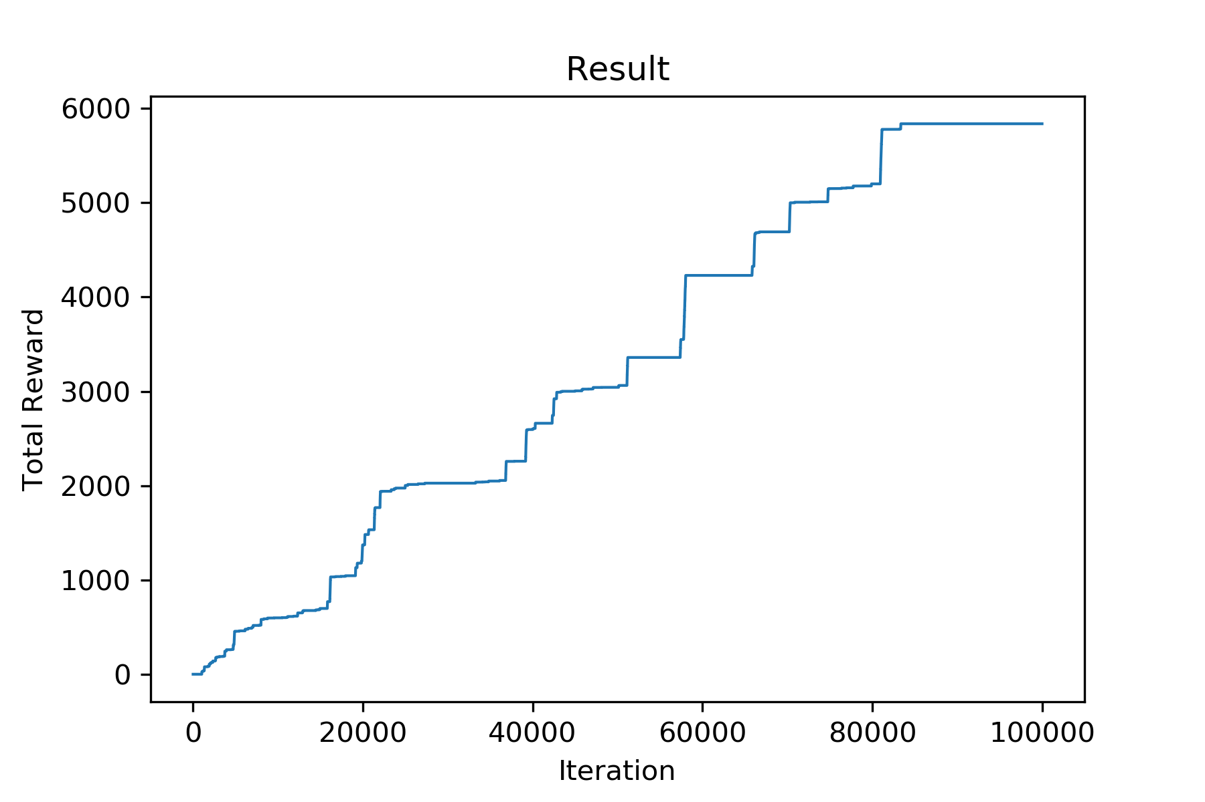
Result – 10,000 Iteration

Slide 10
Result – 100,000 Iteration

Slide 11
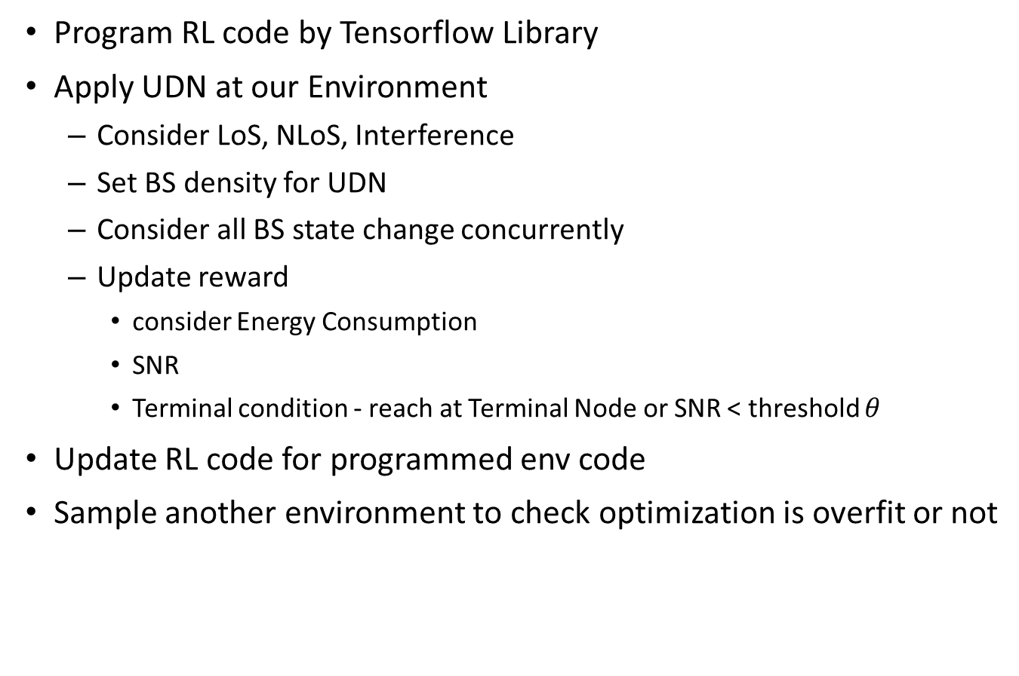
Future plan
Program RL code by Tensorflow Library
Apply UDN at our Environment
Consider LoS, NLoS, Interference
Set BS density for UDN
Consider all BS state change concurrently
Update reward
consider Energy Consumption
SNR
Terminal condition - reach at Terminal Node or SNR < threshold $θ$
Update RL code for programmed env code
Sample another environment to check optimization is overfit or not

Slide 12
Thank you
Any Questions?

